Slide 1

Early Detection of Parkinson through Speech Analysis
Akshay Channam Addanki Naveen Ram Swarup Bavikati

Slide 2
Parkinson’s Disease​
Parkinson’s Disease (PD) is a progressive neurodegenerative disorder primarily affecting dopamine-producing neurons. The disease manifests through motor symptoms such as tremors, rigidity, bradykinesia, and postural instability, along with non-motor symptoms like speech impairments, which are among the earliest indicators.
Despite its prevalence, diagnosing PD remains challenging due to the lack of definitive biomarkers or reliable imaging tools. Symptoms are often detected after significant neuronal loss, delaying intervention. Early diagnosis is critical for better disease management and improved patient outcomes.

Slide 3
Problem Statement
Problem:
Parkinson’s Disease affects millions globally, yet early diagnosis is hindered by the absence of definitive tests. Speech disturbances, observed in 90% of PD patients, are often overlooked despite being an early symptom.
Need for Study:
Challenges in Diagnosis: Imaging and laboratory tests fail to provide conclusive results.
Early Indicators: Voice and prosody alterations are among the first signs of PD.
Solution: Automating voice analysis using machine learning offers a reliable, language-independent approach to detect PD early and non-invasively.
Key Tools for Feature Extraction:
Praat: Acoustic analysis, manual feature extraction, and visualization.
LIBROSA: Standardized tool for processing acoustic data.
OpenSMILE: Open-source software offering automated feature extraction across multiple datasets, including real-time capability.

Slide 4
Speech
Speech as a Biomarker
Speech provides an excellent biomarker for PD as it is non-invasive, cost-effective, and easily monitored. The disease affects multiple components of speech production:
Phonation Changes: Reduced loudness, roughness, tremor in voice.
Articulation Challenges: Imprecise consonants, reduced vowel space, slurred speech.
Prosodic Features: Monotone pitch, variable rate, inappropriate pauses.
These changes are language-independent and detectable in early stages, making speech analysis an effective diagnostic tool.
Speech Disturbances in Parkinson’s Disease:
PD significantly impacts communication, with speech disturbances emerging as one of the earliest and most disabling symptoms:
Prevalence: Almost 90% of PD patients experience hypokinetic speech.
Characteristics:
Monotonous pitch and low tone.
Variable speech speed with inappropriate pauses.
Shortened phrases, articulation decay, and vocal tremors.
These symptoms worsen as the disease progresses, emphasizing the need for diagnostic tools focusing on speech analysis

Slide 5

Why OpenSMILE?
OpenSMILE (Open Speech and Music Interpretation by Large-space Extraction) has become the industry standard for speech feature extraction, widely used in research, clinical applications, and emotion recognition. Its success is rooted in its ability to provide:
Reproducible results backed by active community support and ongoing research validation.
Access to extensive feature sets, enabling both basic and advanced speech analysis.
Application in clinical diagnostics, computational paralinguistics, and real-time processing.
By leveraging OpenSMILE’s advanced toolkits, researchers can extract a wide array of speech and voice quality parameters, making it a versatile solution for tasks ranging from emotion detection to pathology analysis.

Slide 6
Feature Sets in OpenSMILE
OpenSMILE provides flexible feature sets tailored for diverse use cases. Key sets include:
1. ComParE_2016 (6,373 Features)
Designed for computational paralinguistics challenges, this set is ideal for detailed speech analysis, emotion recognition, and research requiring extensive features.
Includes MFCC 1-14, voicing parameters, and spectral analysis.
2. eGeMAPS v01a/v01b (~88 Features)
Purpose-built for clinical applications and voice pathology detection. This compact set emphasizes frequency, energy, and spectral parameters.
v01b improves upon v01a with enhanced stability and bug fixes.
3. GeMAPS v01a/v01b (62 Features)
Designed for real-time and mobile-friendly applications, GeMAPS is the go-to solution for quick voice analysis in resource-constrained environments.
Features include essential frequency metrics and minimal spectral descriptors.
4. emobase (~988 Features)
Specialized for emotion and affect recognition, this set includes prosodic and energy-based features for basic emotion classification.

Slide 7
OpenSMILE Feature Processing
OpenSMILE processes speech features at two primary levels, enabling a balance between precision and computational efficiency.
1. Low-Level Descriptors (LLD):
Conducts frame-by-frame analysis to extract core acoustic features such as fundamental frequency, spectral features, and voice quality.
Focuses on granular details for high-resolution speech characterization.
2. Functional-Level Descriptors:
Aggregates statistical and temporal information from LLDs to derive global descriptors.
Computes metrics such as mean, standard deviation, contour descriptors, and temporal features for a holistic analysis of speech patterns.
This layered approach ensures flexibility, catering to both real-time applications and complex diagnostic tasks.

Slide 8
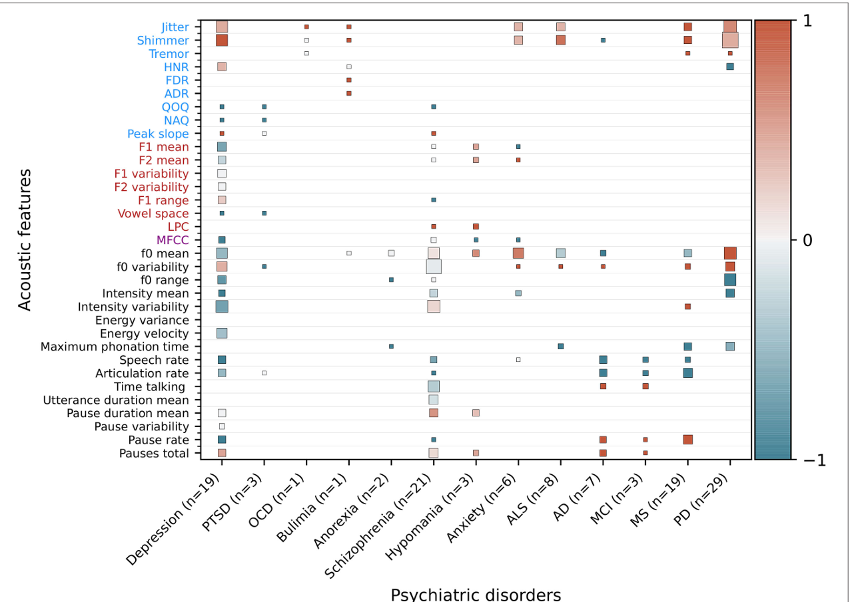
Features Affected

Slide 9
Literature Study
Machine learning approaches to identify Parkinson's disease using voice signal features
Parkinson’s Disease (PD):
Second most common age-related neurological disorder.
Early symptoms often misdiagnosed due to overlap with normal aging or other disorders like essential tremor.
Challenges in Diagnosis:
No definitive lab biomarkers or imaging techniques available.
Voice dysfunction, one of the earliest indicators, offers potential for early non-invasive detection.
Dataset Details:
195 voice recordings from 31 subjects (23 PD, 8 Healthy Controls).
Features include measures like fundamental frequency (Fo), jitter, shimmer, and harmonic-to-noise ratio.
Proposed Methodology:
Utilized Machine Learning (ML) and Deep Learning (DL) models:
Support Vector Machine (SVM), Random Forest (RF), K-Nearest Neighbor (KNN), Decision Tree (DT), Multi-Layer Perceptron (MLP).
Addressed data imbalance using SMOTE (Synthetic Minority Over-sampling Technique).
Enhanced model performance with hyperparameter tuning via GridSearchCV.
Key Findings:
MLP achieved the highest accuracy (98.31%) with excellent precision, recall, and F1-score.
SVM also performed well with 95% accuracy.
Voice-based analysis proves to be a reliable, cost-effective, and non-invasive diagnostic approach.
Significance:
Highlights voice analysis as a biomarker for early PD detection.
Suggests integration into healthcare for accessible, scalable diagnostics.

Slide 10
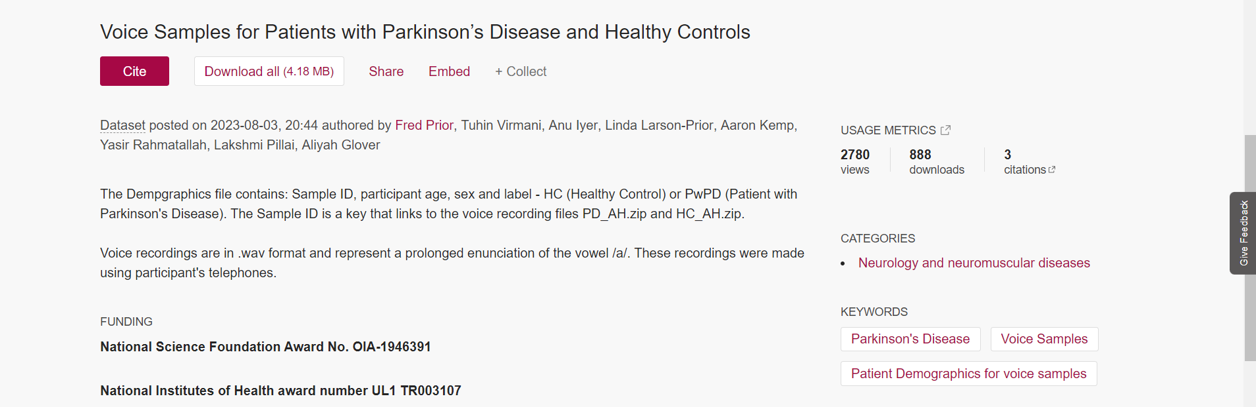
Dataset

Slide 11
1. Data Collection and Preprocessing:
Dataset:
Utilized the Voice Samples for Patients with Parkinson’s Disease and Healthy Controls dataset containing 81 voice recordings from 81 subjects (40 with PD, 41 healthy controls).
Features extracted included measures like fundamental frequency (Fo), jitter, shimmer, and harmonic-to-noise ratio.
Preprocessing Steps:
Class Balancing:
Applied Synthetic Minority Over-sampling Technique (SMOTE) to address data imbalance, ensuring equal representation of healthy and PD samples.
Definition: SMOTE generates synthetic samples for the minority class by interpolating between nearest neighbors in the feature space.
Standardization:
Used StandardScaler to normalize features for consistent data distribution and improved model performance.
Definition: StandardScaler standardizes features by removing the mean and scaling to unit variance.
Adapted Methodologies

Slide 12
Adapted Methodologies
2. Feature Selection:
Applied SelectKBest to identify the most relevant features for classification.
Definition: SelectKBest uses statistical tests to rank features by importance, reducing dimensionality and improving model efficiency.
Top Features Selected: MDVP:Fo(Hz), MDVP:Flo(Hz), MDVP:Shimmer, HNR, PPE, and spread1.

Slide 13
3. Machine Learning and Deep Learning Models:
Trained and tested various algorithms for classification:
Support Vector Machine (SVM):
Separates data using a hyperplane for op
timal class distinction.
Effective for both linear and non-linear separations using kernels.
Random Forest (RF):
Combines multiple decision trees to improve accuracy and reduce overfitting.
K-Nearest Neighbor (KNN):
Classifies data points based on the majority class of its nearest neighbors in feature space.
Decision Tree (DT):
Splits data into branches based on decision rules from features, making it interpretable and efficient.
Multi-Layer Perceptron (MLP):
A type of artificial neural network with one input layer, one or more hidden layers, and an output layer.
Used for non-linear problem solving with backpropagation for weight optimization.
Adapted Methodologies

Slide 14
4. Hyperparameter Tuning:
Used GridSearchCV for systematic exploration of hyperparameter combinations.
Definition: GridSearchCV performs an exhaustive search over a specified parameter grid using cross-validation to find the best-performing model configuration.
5. Performance Evaluation:
Evaluated model effectiveness using key metrics:
Accuracy: Measures overall correctness of the model.
Precision: Proportion of true positives to total predicted positives.
Recall (Sensitivity): Ability to detect true positive cases.
F1-Score: Harmonic mean of precision and recall, balancing the two metrics.
Confusion matrix used to analyze classification outcomes (True Positive, True Negative, False Positive, False Negative).
Adapted Methodologies

Slide 15
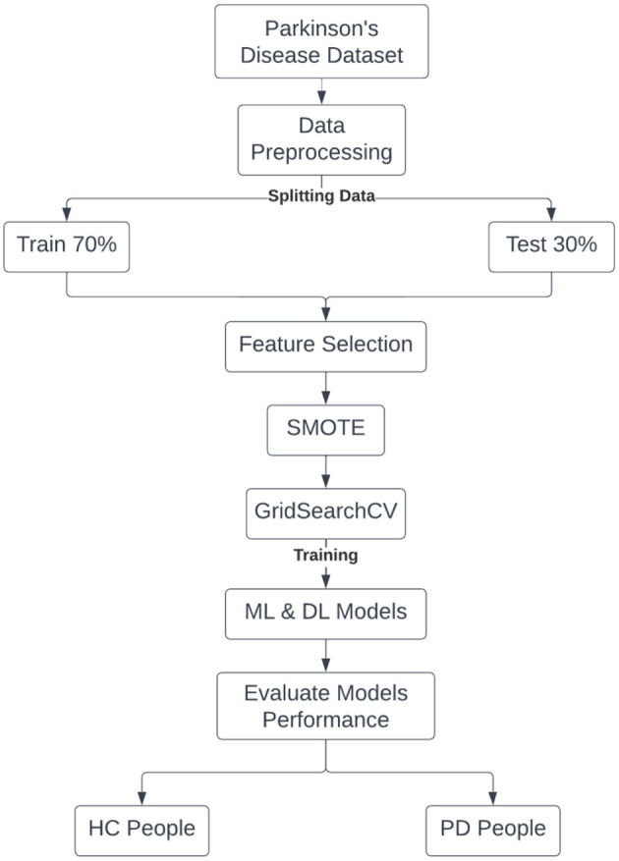
Architecture Diagram

Slide 16
Feature Analysis
Low-Level Descriptors (LLDs)
These are basic acoustic features describing the raw characteristics of the voice, such as frequency and amplitude variations.
Prosodic Features
These relate to rhythm, intonation, and stress in speech, often indicative of voice abnormalities.
Voice Quality Features
These describe the phonatory characteristics of the voice, such as noisiness and tonal quality.
Temporal Features
These capture the timing and sequential aspects of speech, including classification

Slide 17
Features

Slide 18
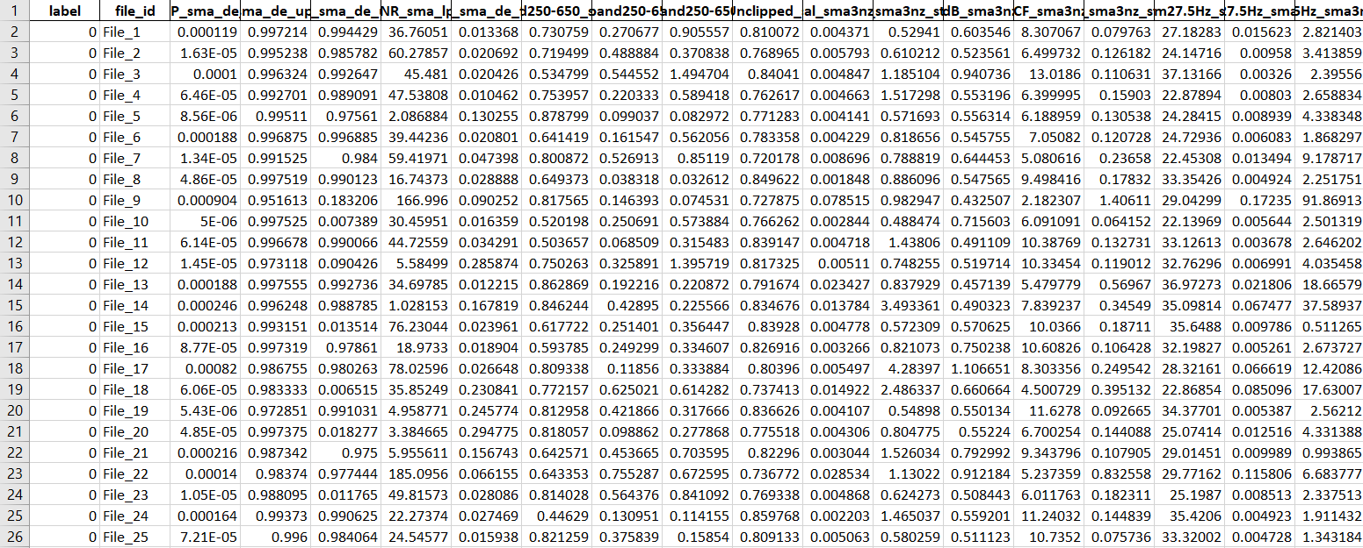
Feature set after extraction

Slide 19
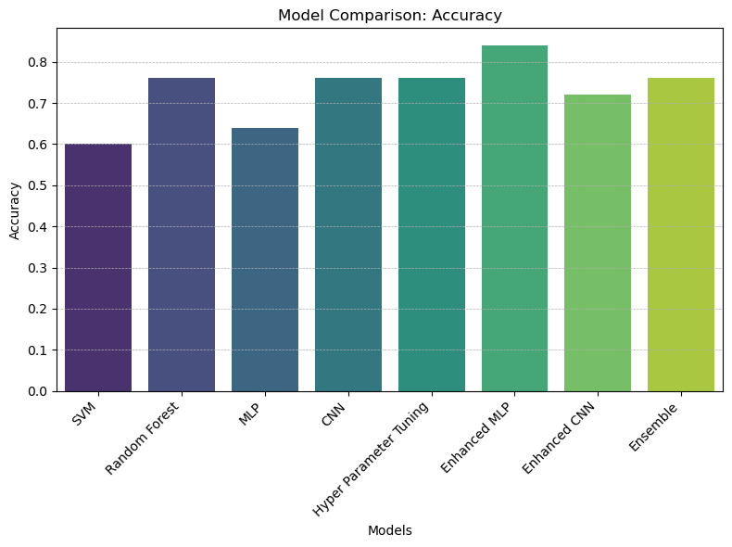
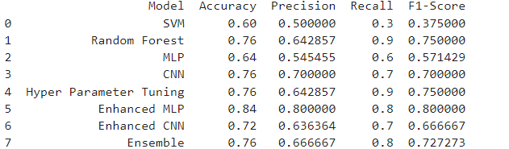
Model Comparison:

Slide 20

Literature Study
A machine learning method to process voice samples for identification of Parkinson’s disease
Objective:
Explore the reliability of low-quality voice recordings collected via telephone for identifying Parkinson’s Disease (PD) using machine learning (ML) and deep learning (DL) approaches.
Innovations:
Novel use of Inception V3 CNN with transfer learning for spectrogram classification.
Analysis of spectrogram images retains temporal and frequency energy distribution of the sustained vowel sound (/a/).
Comparison of deep learning results with traditional statistical classifiers (Random Forest, Logistic Regression).
Key Results:
CNN-based spectrogram analysis achieved AUC = 0.97 for colored spectrograms and AUC = 0.96 for grayscale spectrograms, outperforming traditional methods.
Demonstrated feasibility of using low-quality recordings (8 kHz) for PD detection, supporting clinical applications in resource-limited areas.
Impact:
Simplifies PD diagnosis via non-invasive, accessible, and remote voice-based screening, enabling earlier detection and rural inclusivity.

Slide 21
Adapted Methodologies
1) Data Collection and Preprocessing:
Voice recordings were collected via telephone voicemail at an 8 kHz sampling rate.
Background noise removal using decibel-based filters (75–300 dB for males, 100–600 dB for females).
Trimmed silent segments using short-time energy thresholds.
Result: Processed 1.5-second sustained vowel /a/ samples.
2) Acoustic Signal Features Extraction:
Used Opensmile (Python) interface.
Extracted 23 features:
Fundamental frequency (F0) – mean and standard deviation.
Harmonics-to-noise ratio (HNR).
Jitter (frequency variations) and shimmer (amplitude variations).
Formant frequencies (F1–F4).
Classified using Random Forest and Logistic Regression.

Slide 22
Adapted Methodologies
3. Spectrogram Creation:
Spectrograms generated using Fast Fourier Transform (FFT) with:
32 ms sliding window, 50% overlap, 1024 FFT size.
Represented signal energy across time and frequency axes.
Grayscale and colored spectrograms were created and normalized.
4. Convolutional Neural Network (CNN):
Pre-trained Inception V3 CNN architecture (transfer learning):
Trained on ImageNet database; adapted to classify spectrograms into HC and PwPD.
Fine-tuned with 4 additional layers:
Batch normalization, Dense, Dropout, and Final Dense layers.
Trained with Adam optimizer, 0.001 learning rate, 10 epochs, batch size = 4.
Achieved superior classification with AUC = 0.80 for color spectrograms.
5. Validation and Comparison:
Cross-validation with 70% training and 30% testing in 100 random splits.
Comparison with RF and LR classifiers using acoustic and spectral features.
CNN showed better robustness and smaller variability across iterations.

Slide 23
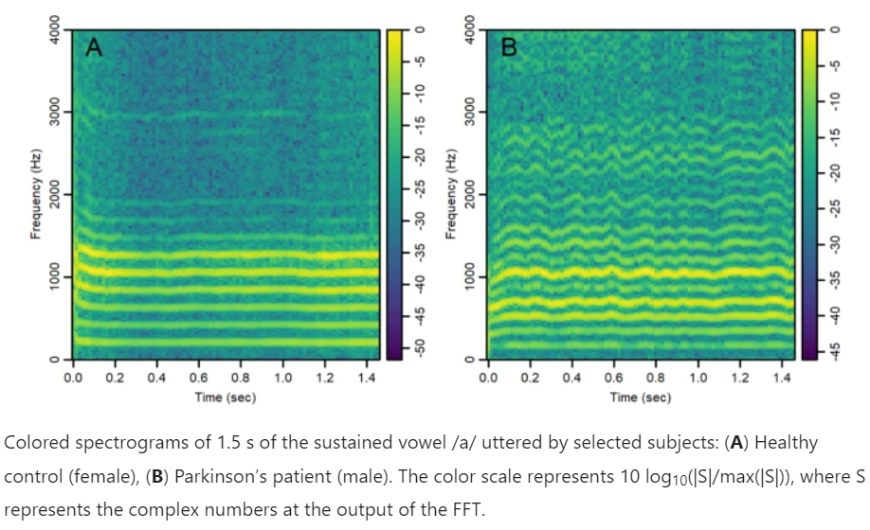
Spectrogram Analysis

Slide 24
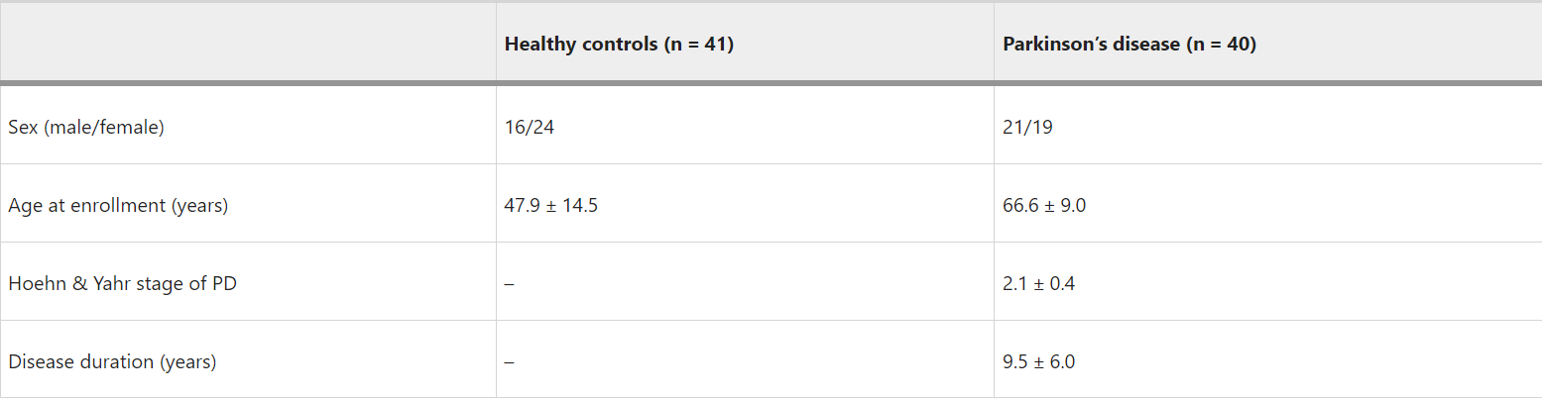
Dataset Analysis

Slide 25
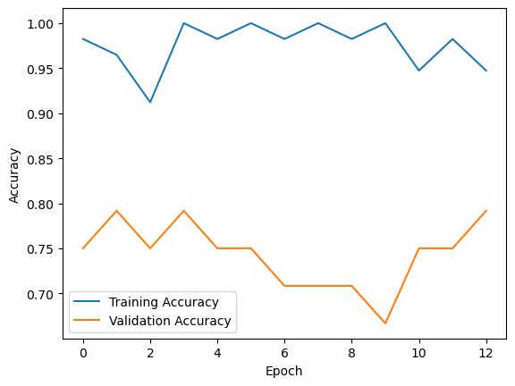
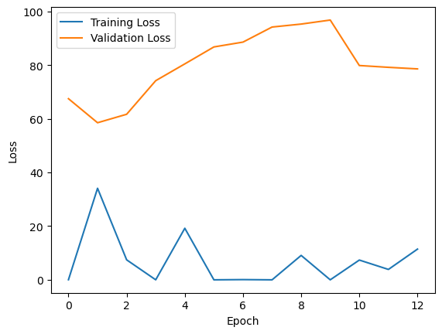
Model Performance
Achieved 80% Accuracy

Slide 26
Our Methodology
Audio Input
Feature Extraction
Feature Normalization
Feature Reduction Techniques
Classification Models
Ensemble Decision

Slide 27
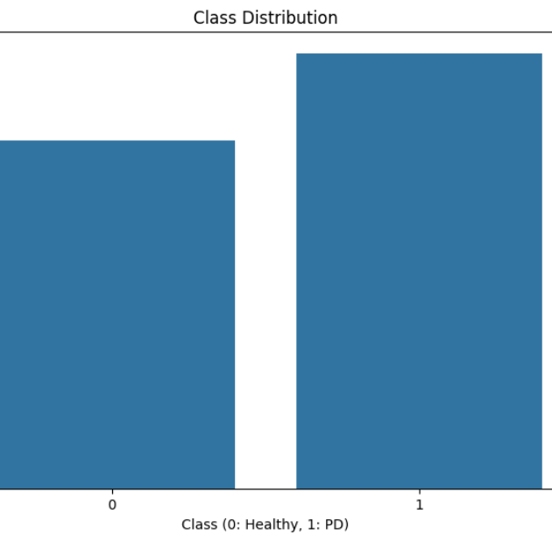
Italian Dataset Analysis
Young Healthy Controls (YHC): 15 individuals (13 males, 2 females), aged 19–29.
Healthy Elderly Controls (HEC): 22 individuals (10 males, 12 females), aged 60–77.
Parkinson's Disease (PD) Patients: 28 individuals (19 males, 9 females), aged 40–80
Number of healthy control samples: 220
Number of PD samples: 275
Processed only the “AAAhh” sounds which are in different patterns
Number of features Extracted: 88

Slide 28
Feature Extraction
OpenSmile eGeMAPS v02 Features:
Frequency-related:
F0 (pitch)
Jitter
Formant frequencies (F1, F2, F3)
Energy/Amplitude-related:
Shimmer
Loudness
Harmonics-to-Noise Ratio
Spectral:
MFCC
Alpha Ratio
Hammarberg Index

Slide 29
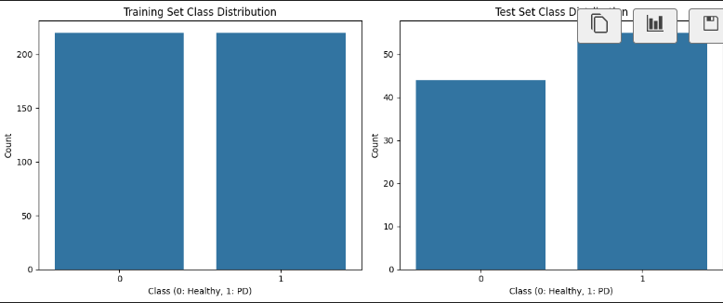
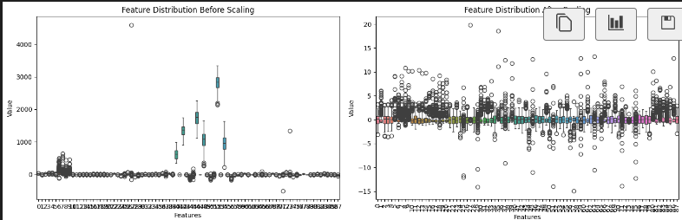
Feature Normalization
StandardScaler application
Robust to outliers

Slide 30
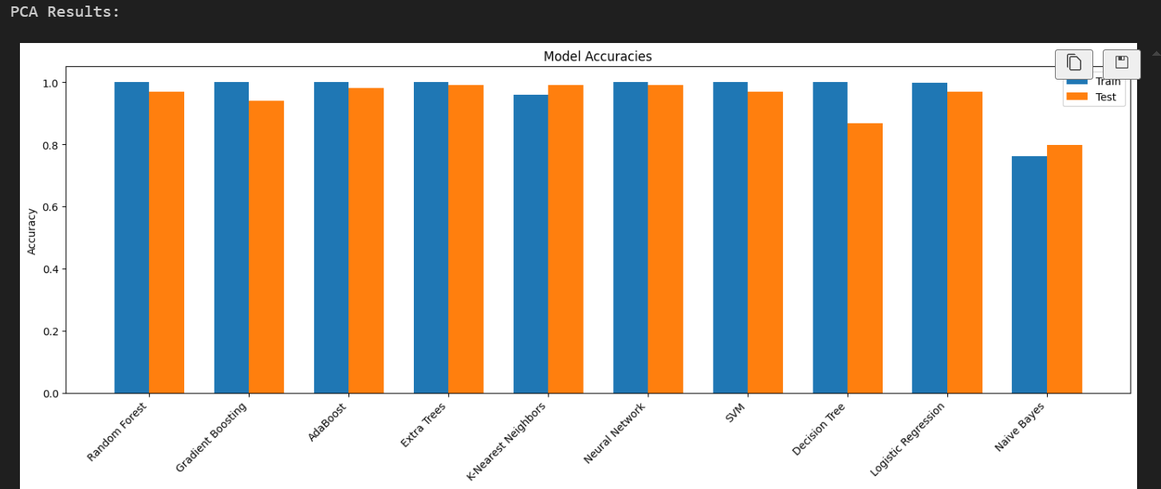
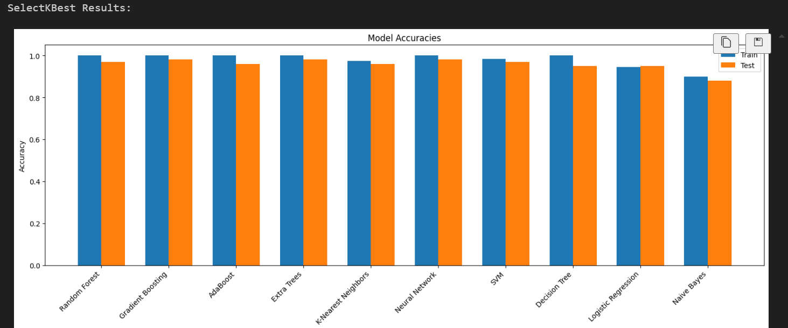
Machine Learning Pipeline
Feature Reduction Techniques:
PCA (20 components)
SelectKBest (20 features)
Classification Models:
Random Forest
Gradient Boosting
SVM
Neural Network
KNN
Decision tree
Naïve Bayes
Logistic Regression
Model Evaluation
Training Results
Cross-validation Scores
Performance Metrics

Slide 31
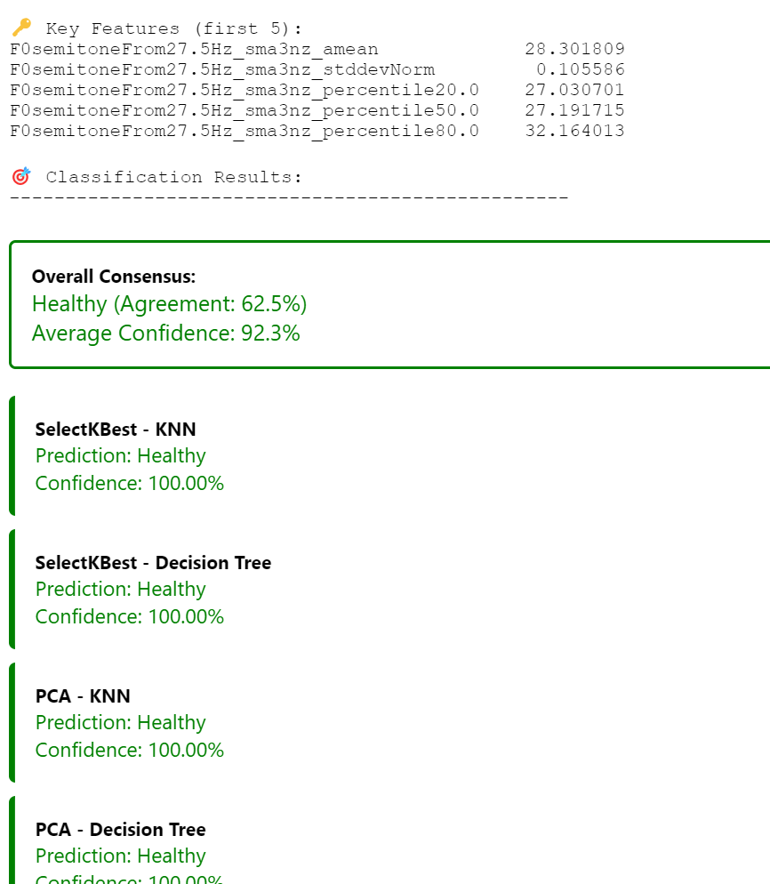
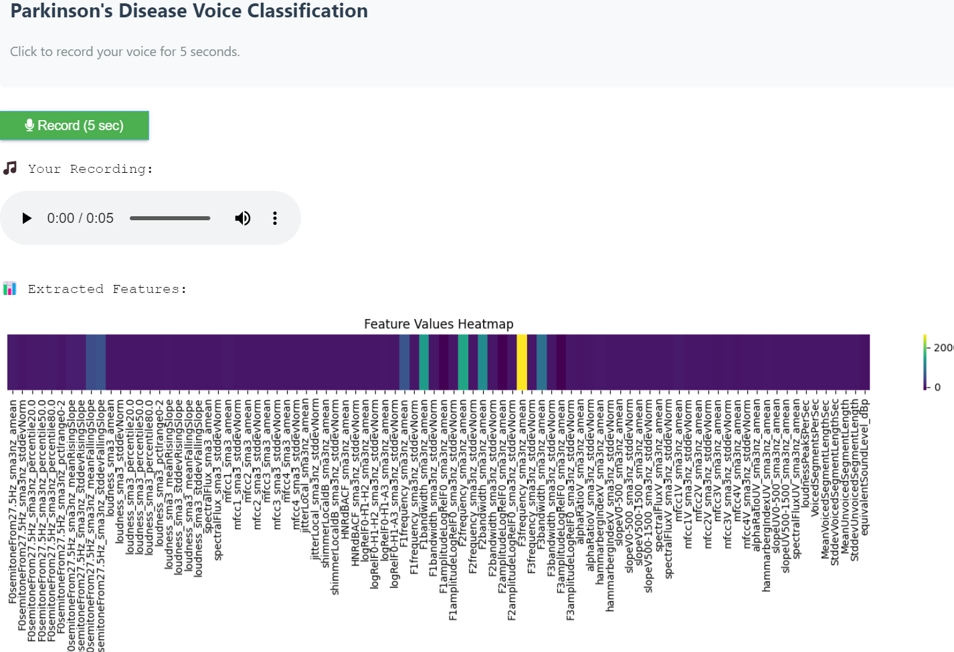
Real-time Classification
Recording Interface
Feature Visualization
Multi-model Predictions
Consensus Decision

Slide 32
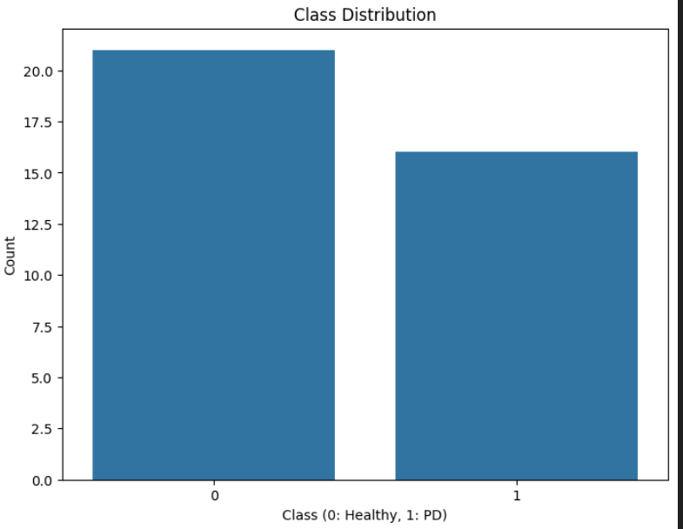
KCL Parkinson's Dataset Analysis
Parkinson’s Disease (PD) Patients: X individuals (male/female distribution), with varying disease severity.
Healthy Controls (HC): X individuals (male/female distribution),
Large dataset includes varied speech tasks for comprehensive analysis.
Has the Both Readtext and SpontaneousDialogue.
Number of healthy control samples: 21
Number of PD samples: 16

Slide 33
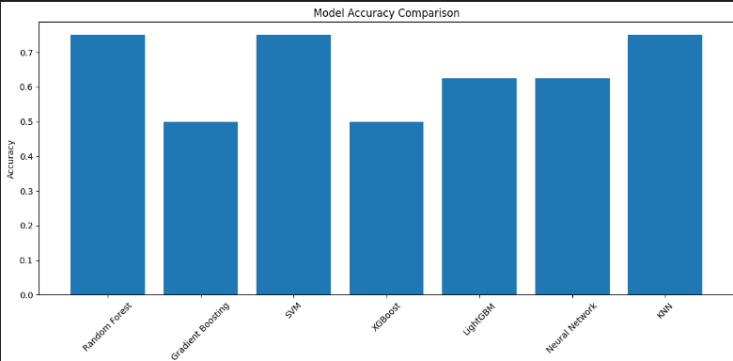
Model Comparison:
RandomForest, KNN, SVM are best performing Algorithms with 75% accuracy

Slide 34
Future Scope
Real-Time Monitoring Tools
Create mobile and wearable applications for continuous speech-based monitoring of PD progression..
Development of Multilingual Models
Build language-independent frameworks to accommodate diverse linguistic populations.
Integration with Telemedicine Incorporate speech analysis systems into telehealth platforms for remote and cost-effective diagnosis..
Combining Multimodal Data
Integrate speech features with other biomarkers like gait and handwriting for comprehensive diagnostics.
Personalized Treatment Plans
Use speech data to track individual disease progression and tailor therapeutic approaches
Early Diagnosis Enhancement Develop systems to identify pre-symptomatic markers, aiding in early intervention strategies.

Slide 35
References
Italian Parkinson dataset : Italian Parkinson's Voice and Speech | IEEE DataPort
KCL dataset :Mobile Device Voice Recordings at King's College London (MDVR-KCL) from both early and advanced Parkinson's disease patients and healthy controls
Comparative Study of Speech Analysis Methods to Predict Parkinson’s Disease2111.10207
Voice Analysis for Neurological Disorder Recognition–A Systematic Review and Perspective on Emerging Trendshttps://doi.org/10.3389/fdgth.2022.842301
Automated Assessment of Psychiatric Disorders Using Speech: A Systematic ReviewOSF Preprints | Automated Assessment of Psychiatric Disorders Using Speech: A Systematic Review

Slide 36
Thank you !

